Slide 1

Level 5 - HTQ
Unit 549 – Developing, Managing & Leading Teams

Slide 2
Unit 549 – Developing and Managing & Leading Teams
Learning Outcome 1 Understand approaches to developing, managing and leading teams
Learning Outcome 2 Understand approaches to achieving a balance of skills and experience in teams
Learning Outcome 3 Know techniques for leading individuals and teams to achieve success
Learning Outcome 4 Be able to apply your skills in managing talent and performance

Slide 3
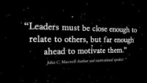

Slide 4
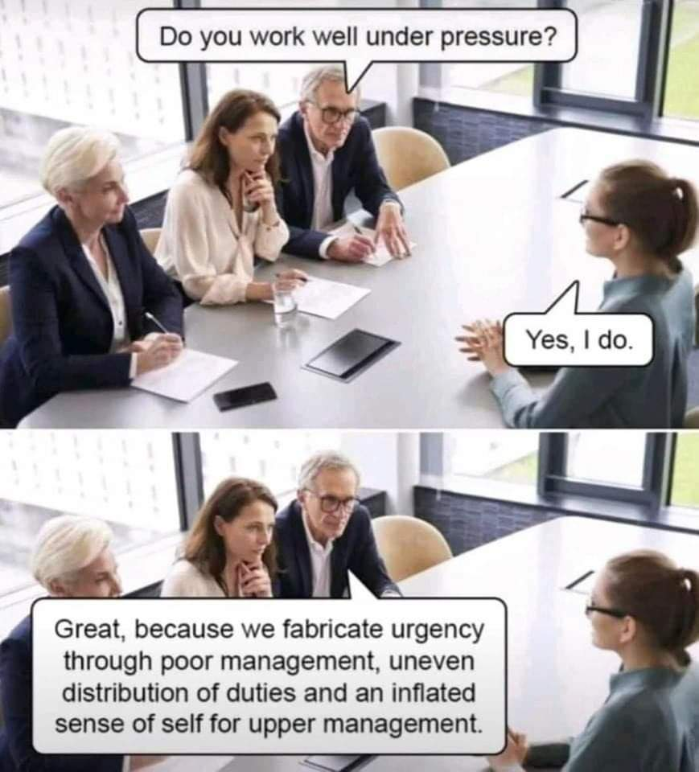

Slide 5
What is Leadership?
“The behaviour of an organisation’s leaders should create clarity and unity of purpose within the organisation, and an environment in which the organisation and its people can excel”
European Foundation for Quality management (EFQM)
Notes:
Armstrong (1990) defined leadership in terms of “getting things done through people”. He suggests that leadership happens when there is an objective to be achieved, or a task to be carried out, and when more than one person is needed to do it.
All managers are by definition leaders in that they can only do what they have to do with the support of their team, who must be inspired or persuaded to follow them.
Leadership is therefor about encouraging and inspiring individuals and teams to give their best to achieve a desired result.
Leadership is required because someone has to point the way and ensure that everyone concerned gets there. Organisational effectiveness depends on the quality of leadership.

Slide 6
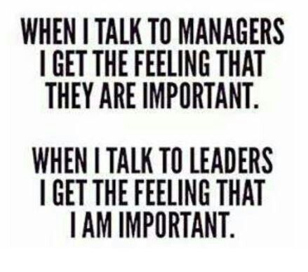
Notes:
How many times have you felt like this when you talk to a manager?

Slide 7
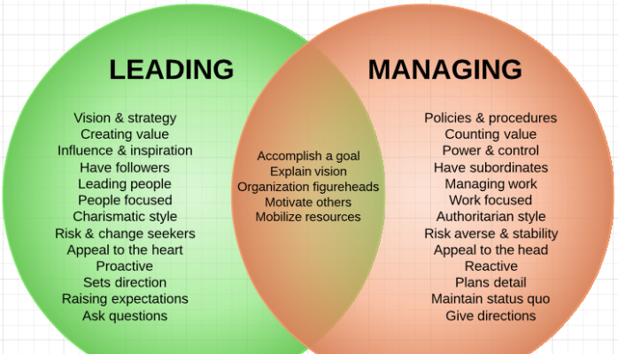

Slide 8
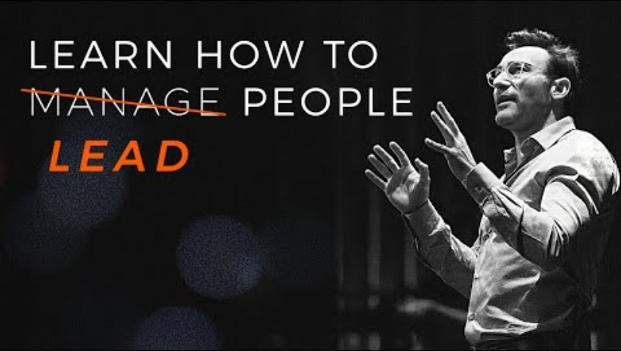

Slide 9

Difference Between Leadership & Management?
Leadership is the ability to continuously influence a team of individuals and encompasses many important traits.
While management is the overall direction and oversight of the work activities of a team, oversight of the work activities of a team, leadership focuses on the ongoing motivation engagement and productivity of a team.

Slide 10
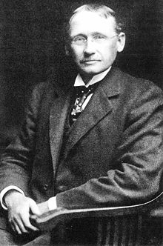
Scientific management
is a theory of management that analyses and synthesizes workflows. Its main objective is improving economic efficiency, especially labour productivity. It was one of the earliest attempts to apply science to the engineering of processes to management. Scientific management is sometimes known as Taylorism after its pioneer, Frederick Winslow Taylor.^{[1]}
Although scientific management as a distinct theory or school of thought was obsolete by the 1930s, most of its themes are still important parts of industrial engineering and management today. These include analysis; synthesis; logic; rationality; empiricism; work ethic; efficiency and elimination of waste; standardisation of best practices;
Notes:
Taylor's four principles are as follows:
Replace working by "rule of thumb," or simple habit and common sense, and instead use the scientific method to study work and determine the most efficient way to perform specific tasks.
Rather than simply assign workers to just any job, match workers to their jobs based on capability and motivation, and train them to work at maximum efficiency.
Monitor worker performance, and provide instructions and supervision to ensure that they're using the most efficient ways of working.
Allocate the work between managers and workers so that the managers spend their time planning and training, allowing the workers to perform their tasks efficiently

Slide 11
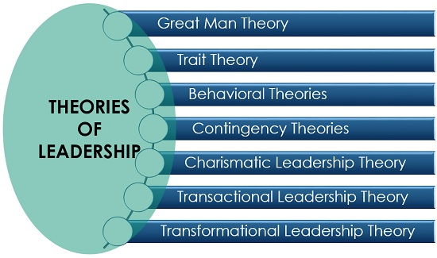
Notes:
"Great Man" Theories
Have you ever heard someone described as "born to lead?" According to this point of view, great leaders are simply born with the necessary internal characteristics such as charisma, confidence, intelligence, and social skills that make them natural-born leaders.
Great man theories assume that the capacity for leadership is inherent—that great leaders are born, not made. These theories often portray great leaders as heroic, mythic, and destined to rise to leadership when needed. The term "Great Man" was used because, at the time, leadership was thought of primarily as a male quality, especially in terms of military leadership.
Such theories suggest that people cannot really learn how to become strong leaders. It's either something you are born with or born without. It is very much a nature (as opposed to nurture) approach to explaining leadership.
Trait Theories
Similar in some ways to Great Man theories, trait theories assume that people inherit certain qualities and traits that make them better suited to leadership. Trait theories often identify a particular personality or behavioral characteristics shared by leaders. For example, traits like extroversion, self-confidence, and courage are all traits that could potentially be linked to great leaders.
If particular traits are key features of leadership, then how do we explain people who possess those qualities but are not leaders? This question is one of the difficulties in using trait theories to explain leadership.
There are plenty of people who possess the personality traits associated with leadership, yet many of these people never seek out positions of leadership. There are also people who lack some of the key traits often associated with effective leadership yet still excel at leading groups.¹
Behavioral Theories
Behavioral theories of leadership are based upon the belief that great leaders are made, not born. Consider it the flip-side of the Great Man theories. Rooted in behaviorism, this leadership theory focuses on the actions of leaders, not on mental qualities or internal states. According to this theory, people can learn to become leaders through teaching and observation.
Contingency Theories/Situational
Contingency theories of leadership focus on particular variables related to the environment that might determine which particular style of leadership is best suited for the situation. According to this theory, no leadership style is best in all situations.
Leadership researchers White and Hodgson suggest that truly effective leadership is not just about the qualities of the leader, it is about striking the right balance between behaviors, needs, and context.²﻿
Good leaders are able to assess the needs of their followers, take stock of the situation, and then adjust their behaviors accordingly. Success depends on a number of variables including the leadership style, qualities of the followers, and aspects of the situation.
Studies describe charismatic leaders as highly influential and confident individuals who hold strong beliefs. ... They are change agents who communicate their vision to others, set high expectations, attend to the needs of their followers, and behave in unconventional ways

Slide 12
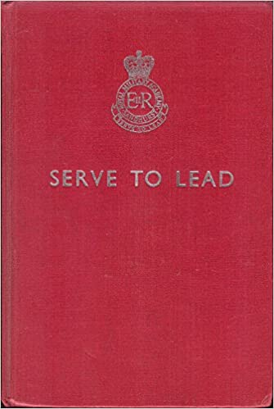
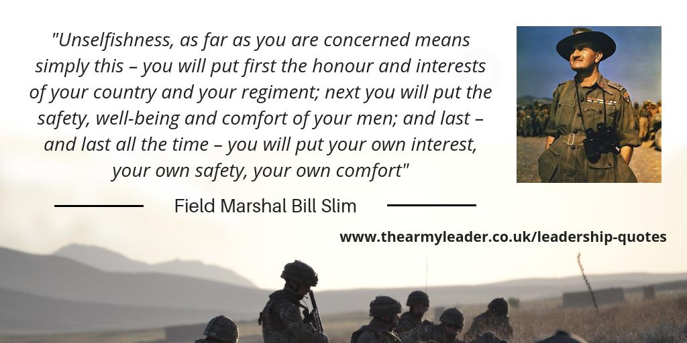
Servant Leadership
Notes:
Leaders have certain concerns and take certain actions that distinguish them as leaders. These concerns and actions are constitutive of leadership, since they constitute, or create leadership. They are also regularities of leadership we can recognize. ... Leaders build power for themselves and others.
The magnum opus of Robert Greenleaf, Servant Leadership is a recent theory of leadership that argues that the most effective leaders are servants of their people. ... Servant leaders get results for their organization through whole-hearted attention to their followers and followers' needs.
Read First then reveal Book Cover:
Not only does a leader have an obligation to help make sense of a situation, he or she also has an obligation to give it meaning - to communicate what is most important and why. Sandhurst's motto, Serve to Lead, sums up its message that the men and women you are responsible for are your first priority.
Then Reveal Slim who said it best.

Slide 13
What is emergent leadership?
Emergent leadership occurs when a group member is not appointed or elected as leader, but rather that person steps up as the leader over time within group interactions. It also empowers team members to make decisions outside the traditional structure of a business organization.
Emerging leaders are collaborative, great teammates, and good communicators. They seek others' input and opinions, use it to shape their ideas, and generate consensus. They have strong soft-skills and have emotional intelligence when it comes to dealing with others.
Notes:
This model is based on Tuckman's (1965) group-development sequence proposed by Stein, Hoffman, Cooley, & Pearse in 1979. According to this model, the process of emergent leadership passes through three distinct stages; Orientation, Conflict, and Emergence.

Slide 14

Traits of Great Leaders
Define what makes a great leader?
Identify some great leaders to act as role models?
Notes:
Anita Roddick (founder of the body shop)
Richard Branson
Lord Alan Sugar
Frank Stronach (Magna International )
Sir Winston Churchill
President John Kennedy
Martin Luther King ( I have a dream speech)
Ghandi
Angela Merkel
Alan Mulally (CEO Ford – Saved the company from bankruptcy)
Paul Poleman (CEO Unilever)
Fred Smith ( CEO for Fedex for over 40 years, who even knew we needed a company like this…)
Peter Jones
Margret Thatcher
Jamal Edwards ( a young entrepreneur – owns SBTV making music videos for YouTube)

Slide 15

Approaches to Leadership
Qualities
Positional Power – Transactional
Personal Power –Transformational
Situational
Action Centred
Notes:
An understanding of the theories will allow you to adapt to different scenarios e.g projects, ongoing routine business, leading multiple teams, remote teams etc.

Slide 16
Bernard Bass
Transformational Leadership:
Idealised Influence.
Inspirational Motivation.
Intellectual Stimulation.
Individualised Consideration.
Transactional Leadership
Notes:
Transformational and Transactional Leadership Model – Bass (1985)
In the mid-1980s, Bernard Bass asserted that leadership could be depicted along a single
continuum from transformational leadership, to transactional leadership to laissez-faire leadership
with transformational leadership being the most preferable.
The model shows the comparison between transformational leadership (which is about motivation,
clear vision and challenging followers) with the more traditional approaches such as transactional
and laissez-faire styles.
The components that come together to make transformational leadership Bass called
transformational factors. There are four:
Idealized Influence – this factor describes leaders who display a strong moral compass and ethical
values. They become role models that followers want to emulate. These leaders demonstrate
high-integrity meaning they are fair and consistent and are seen to always make the best
decisions. The leader ‘doing the right thing’ emanates from this strong core.
Inspirational Motivation – the transformational leader provides inspiration through a compelling
vision. This motivates team members to create a shared goal. It demands high standards from all
in order to fulfil the vision.
Intellectual Stimulation – team members are encouraged to be creative in solving problems and
to challenge both themselves and the leader when needed. The development and growth of
both leader and team member is encouraged. This factor is about encouraging innovation and
bringing new approaches and ideas to overcoming problems in order to find the best way to
achieve the vision.
Individualised Consideration – like Adair’s circle for the needs of the individual this factor is
about coaching and mentoring team members. It encourages delegation of work to develop both
the team and the individuals. As well as assisting in solving problems and making decisions this
factor also provides support and encouragement.
The leader, in order to be providing transformational leadership, should apply all four of these factors
to their work. The leader therefore has the responsibility to lead with integrity, be a role model,
create an inspiring vision and to communicate the vision. It also requires the leader to encourage
team members to challenge the leader and themselves to be creative in delivering the vision.
Transactional Leadership – is an umbrella term used to describe most of the other nontransformational
forms of leadership models and theories discussed so far. This is where the leader
directs, supports, tells, sells or focuses on a task or individual in order to move towards achieving
goals. It involves a bargain or transaction between the leader and team members.
Transactional leadership can be constructive, but also, at times, coercive – for example the
approach could be ‘if you don’t do this you wont get that’. Much of what we know and expect of
leadership can come from this transactional approach with agreements, contracts, pre-set awards,
inducements and bargains made for doing the work.
Whilst transactional factors are going to be present in the workplace this does not stop the leader
from applying the principles of transformational leadership.
Leadership is a process and can be learned. Leaders will find they might be comfortable with
some aspects of transformational leadership and need to develop others. For example they may
consider themselves to act with integrity and provide a vision (idealised influence and inspirational
motivation), but need to develop their coaching skills to improve their individualised consideration.

Slide 17
Kurt Lewin’s Leadership Styles
Autocratic | Democratic | Laissez-faire
Do things their way only. Do not consult with others and insist on having their own way. Make decisions based on the needs of the task, not the people. | Allow other people to be involved in the decision-making process. Are consultative and value the opinions of others Are influenced by what other people want. Are concerned with building relationships with their team members Are keen to encourage team members to discuss ideas and suggestions. | Trust their team’s capabilities and are willing to stand back and let the team get on with the tasks. Have minimal input and involvement. Let the team make the majority of the day-to-day decisions and implement the work processes.
Notes:
There are many theories and discussions about leadership styles. One management theorist, Kurt
Lewin, identified the following leadership styles:
Autocratic
Do things their way only.
Do not consult with others and insist on having their own way.
Make decisions based on the needs of the task, not the people.
This can be useful if there is a crisis or a situation that needs quick, assertive leadership – e.g. for inexperienced team members who need close supervision or in an emergency. The style can be very demotivating and frustrating to experienced and skilled staff.
Democratic
Allow other people to be involved in the decision-making process.
Are consultative and value the opinions of others
Are influenced by what other people want.
Are concerned with building relationships with their team members
Are keen to encourage team members to discuss ideas and suggestions.
This can make for a very engaging and easy-going working environment, although it can be frustrating if the leader is timid about making final decisions.
Laissez-faire
Trust their team’s capabilities and are willing to stand back and let the team get on with the tasks.
Have minimal input and involvement.
Let the team make the majority of the day-to-day decisions and implement the work processes.
This can be very motivating for team members, and the leader is able to step back and take an overview of the whole operation, moving in to take action only when required. This style works with experienced and well-motivated team members, but is not appropriate for unskilled or unmotivated staff.

Slide 18
Tannenbaum and Schmidt’s Continuum of Leadership Behaviour
TELLS | SELLS | CONSULTS | JOINS
The manager identifies a problem, makes decisions unilaterally without consulting anyone, and without giving much thought to their subordinates | The manager maintains control but they spend time persuading staff about the benefits of their decisions | The manager identifies the problem but does not make the final decision until the team members have suggested solutions. | The manager defines the limits of the possible decisions that can be made by the team, then makes the final decisions along with the team members
When would you use this? | When would you use this? | When would you use this? | When would you use this?
Notes:
Tannenbaum and Schmidt’s Continuum of Leadership Behaviour
Tannenbaum and Schmidt’s Continuum of Leadership Behaviour was written in 1958, and updated in 1973. It is often referred to as ‘Tells, Sells, Consults and Joins’. The four main leadership and management styles covered by the theory are:
• Tells – the manager identifies a problem, makes decisions unilaterally without consulting anyone, and without giving much thought to their subordinates
Q - When would you use this?
Answer: When the decision can only be made by the leader, if there is any danger or emergency.
• Sells – the manager maintains control but they spend time persuading staff about the benefits of their decisions
Q - When would you use this?
Answer: When the Manager wants to explain the reasoning for the decision.
Q - Why would a manager do this?
Answer: To get buy in.
• Consults – the manager identifies the problem but does not make the final decision until the team members have suggested solutions.
Q - When would you use this?
Answer: Where you want suggestions and ideas from the team.
Q - Why would a manager do this?
Answer: Because the team are the SME’s
• Joins – the manager defines the limits of the possible decisions that can be made by the team, then makes the final decisions along with the team members
Q - When would you use this?
Team night out.
Q - What are the factors to consider here before you decide which approach to take?
Danger / Urgency of decision
Involvement or team buy in
Risk
Expertise of team
Cost
Time
Customer
Task and decision
Culture

Slide 19
Hersey and Blanchard’s Situational Leadership Model
DIRECTING LEADERS | COACHING LEADERS | SUPPORTING LEADERS | DELEGATING LEADERS
The leader defines the role, makes the decisions and supervises team members closely. Communication is largely one-way. | The leader still defines the tasks but asks for suggestions and ideas from the team members. Decisions are still the leader’s responsibility, but communication is much more two-way. | The leader passes day-to-day decisions, such as task allocation, to the team members. The leader facilitates discussions, and takes part, but control is passed to team members. | The team is largely self-managing. The leader is still involved with making decisions and solving problems, but the team members have control and decide when and how the leader will be involved.
Notes:
Hersey and Blanchard’s Situational Leadership Model
Hersey and Blanchard’s Situational Leadership Model
This model illustrates the leadership style needed to develop a team, based on the amount of direction and support they need. It is based on four types of leadership style:
Style 1 – Directing leaders
The leader defines the role, makes the decisions and supervises team members closely. Communication is largely one-way.
Style 2 – Coaching leaders
The leader still defines the tasks but asks for suggestions and ideas from the team members. Decisions are still the leader’s responsibility, but communication is much more two-way.
Style 3 – Supporting leaders
The leader passes day-to-day decisions, such as task allocation, to the team members. The leader facilitates discussions, and takes part, but control is passed to team members.
Style 4 – Delegating leaders
By now, the team is largely self-managing. The leader is still involved with making decisions and solving problems, but the team members have control and decide when and how the leader will be involved.

Slide 20
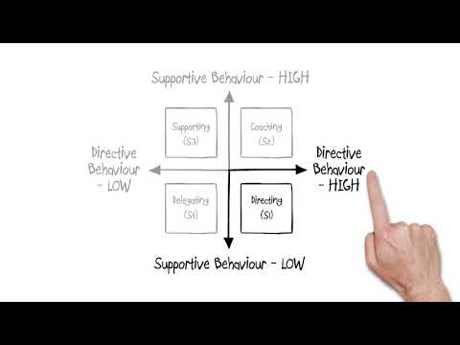
Notes:
Discuss What goes with what, reveal answer.

Slide 21
ACTION CENTRED LEADERSHIP
PERFORM THE TASK
MAINTAIN THE TEAM
DEVELOP THE INDIVIDUALS
Notes:
Adair’s Action-Centred Leadership Model
John Adair developed a practical management and leadership model which can be applied to any
organisation. The Action-Centred Leadership Model is based on three overlapping areas:
• achieving the task
• building and maintaining the team
• developing the individual
To support the leader’s work in these three areas, Adair states that there are eight leadership
functions that need to be met and constantly developed to ensure success:
1 – Defining the task
2 – Planning
3 – Briefing
4 – Controlling
5 – Evaluating
6 – Motivating
7 – Organising
8 – Setting a good example
According to Adair, leadership and management are not the same, although they are connected.
Leadership is about giving direction for change, developing teams and inspiring others.
Management is about the effective and efficient use of resources each day.

Slide 22

To develop individuals a leader….
1:1 meetings
Encourages quiet team members
Channels extroverts’ energy
Recognises particular skills
Gives individual feedback
Coaches and develops
Motivates and encourages

Slide 23

To maintain the team a leader….
Sets standards
Establishes team values
Sets an example
Seeks ideas and opinions
Manages conflict
Clarifies issues
Keeps the team informed

Slide 24

To perform the task a leader…
Initiates and defines the task
Sets standards
Sets policies and procedures
Seeks information from the team
Analyses problems
Makes decisions
Monitors and evaluates performance

Slide 25
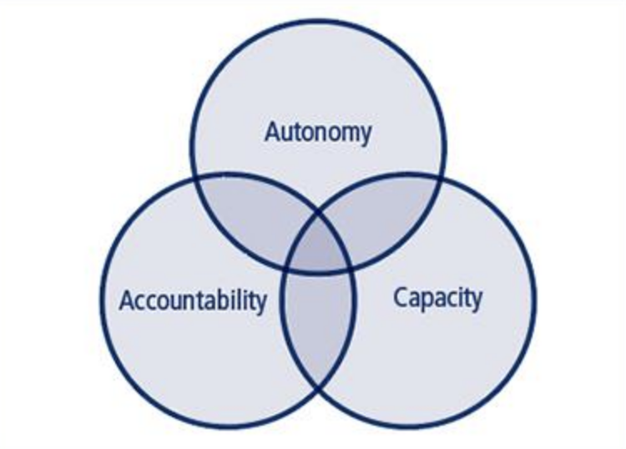
Distributed Leadership
Notes:
The Concept
The majority of leadership models generally concern themselves with discussing the attributes and behaviours of individual leaders. However, distributed leadership is a relatively recent concept which argues for a more systemic approach to leadership.
In distributed leadership models, leadership is more dissociated from designated organisational roles and instead the actions of all individuals at all levels of responsibility are recognised as integral to the organisation and successful functionality of the group or company.
Spillane (2006) summarises that distributed leadership puts leadership - as a concept '- centre stage' rather than the individual leaders themselves.
In distributed models, leadership is considered a group quality, ignoring binary ideas of leader-follower functionality, where all responsibility lies in the hands of the leader, and all followers are subservient.
It can, therefore, facilitate the distribution of responsibility between individuals within an organisation based on expertise, rather than on experience within a role.

Slide 26
Factors that affect leadership styles
Styles of leadership are affected by external factors, such as the organisational environment, demographics, staff characteristics, resources, economic and political factors, technology and the culture of the organization
These May include:
Sex,
The level of management,
Management area,
The nature of the economic activity of an organization,
The number of direct subordinates.
Notes:
Understand Self Awareness techniques, your own leadership style, Emotional Intelligence, Unconscious Bias.
Refer back to the Cultural models discussed in Unit 520 Handy etc..

Slide 27

Creating an Environment of Trust and Respect
• Genuinely seek out and value the contributions of others
• Seek, value and respond to feedback from others, especially our teams
• Communicate honestly and openly
• Be trusted with what others tell us – act with discretion
• Acknowledge honestly and fairly the good work of others
• Develop the ability to suspend judgment when needed
• Take responsibility for our mistakes and show that we can learn from them
• Keep our promises
• Act and behave consistently
• Seek out solutions and not blaming
Notes:
In order to be trusted we have to demonstrate trustworthiness (Covey, 1992 pp. 171). To
demonstrate trustworthiness we need to fully demonstrate and genuinely live the points in
the bullets above. Done authentically this will demonstrate trustworthiness, which if delivered
consistently over time will lead to the building of trust. This is very similar to respect being built
out of consistently being respectful.

Slide 28

Effective Leaders Have….
……..Intelligence
…….Initiative
…………..Self Confidence
……….Helicopter Effect

Slide 29
Tips For Managing Multiple Teams in Multiple Locations
Keep Procedures Consistent.
Be Present.
Let Go of Micromanaging Tendencies. ...
Encourage Friendly Competition.
Use an Employee Management System.
Delegate.
Communicate and Share
Notes:
Tips For Managing Multiple Teams in Multiple Locations
Keep Procedures Consistent. ...
Be Present. ...
Let Go of Micromanaging Tendencies. ...
Encourage Friendly Competition. ...
Use an Employee Management System. ...
Delegate. ...
Communicate and Share.
Keep Procedures Consistent
Multiple locations may come with their own set of necessities, especially if the locations are drastically different layouts or if they serve different purposes, but keeping your base procedures consistent across locations is key to creating a situation that is much easier to manage. Keep the employee handbook consistent across all locations as well as training and shift structure. Keeping these base procedures consistent across the board makes it easier to assign your employees to pick up a shift at a different location in a last minute pinch without additional training.
Be Present
As manager of multiple locations, you may be more involved with one location than the others, but you should still maintain a regular presence across your multiple locations, whether that means visiting each location at least once per week, or if that’s not possible, holding a regular conference call with shift leaders to makes sure everything is running smoothly and to show them that you are there for support. This means more intentional effort on your part to reach out and create regular communication since you won’t have as many opportunities for an “Oh by the way…” feedback moment. A location where your managerial presence is not consistent may become overly relaxed on store procedures, which could result in a loss of sales. Visiting each store regularly keeps employees on their toes and also shows that you care about taking the time to personally make sure each location has what it needs to thrive. Don’t be afraid to take full advantage of technology to maintain a presence at each location. If it’s too much of a hassle or too far for you to commute between locations on a regular basis, take advantage of video chat services such as Google Hangouts or Skype to easily stay in touch with various locations.
Let Go of Micromanaging Tendencies
While it’s important to maintain a presence at each location, it’s impossible (not to mention frustrating for everyone) if you attempt to micromanage across all locations. As your business expands, you need to be able to trust your employees and hire assistant managers or shift supervisors who can help you manage each location when you are not around. Creating a solid structure among your employees so that they have someone to go to for day-to-day questions and small issues that may arise when you’re not around will take some of the pressure off of you as manager. It can also create a greater sense of responsibility and dedication among your employees.
Encourage Friendly Competition
Having multiple locations gives you as a manager the chance to solidify a team environment at each location. Schedule your employees at different locations every once and awhile so that they become familiar with your employees at other locations and then encourage friendly competition for most sales in a month. You could even create a “bracket-style” competition within each store so that playoffs are between winners of employees from different stores (think: barista competition, checkout speed competition, or table prep competition). Keeping things fun and friendly helps your employees better cooperate to making managing a bit more easy (and fun).
Use an Employee Management System
Maintaining schedules is more difficult than ever when you’re dealing with multiple locations and more employees to go along with them. As such, it’s imperative that you use a scheduling and management system that is user friendly for both you and your employees, keeps everything organized, and makes adjustments easy and instant across all locations.
When I Work is an easy-to-use employee scheduling app that makes scheduling easy and sends notifications and reminders straight to their phones so they are alerted immediately about any changes or messages about their shifts and which location each shift is at.
Delegate
Your job will be much more stressful if you don’t delegate the bulk of your work (before you manage multiple locations) to other people. When it comes to the day-to-day duties at each location, these are things that your employees can handle. Assign tasks to different people and make sure that your work is based on larger, overarching tasks, rather than location-specific tasks. It may feel like you’re shucking your responsibilities, but it will truly make managing multiple locations easier for you as well as your employees if you are not overwhelmed and if they can have more internal control over their specific locations (set within the regular procedures you set for them, of course).
Communicate and Share
It’s important that you spread information across your locations evenly and simultaneously. No one can be left out of information if you want to manage effectively across several locations. Choose one main method of communication and stick to that so that no piece of information is missed such as a newsletter updating everyone to new procedures or information that is pertinent to the company as a whole

Slide 30

Behavioural Styles?
A behavioural style refers simply to how someone acts at any one time.

Slide 31
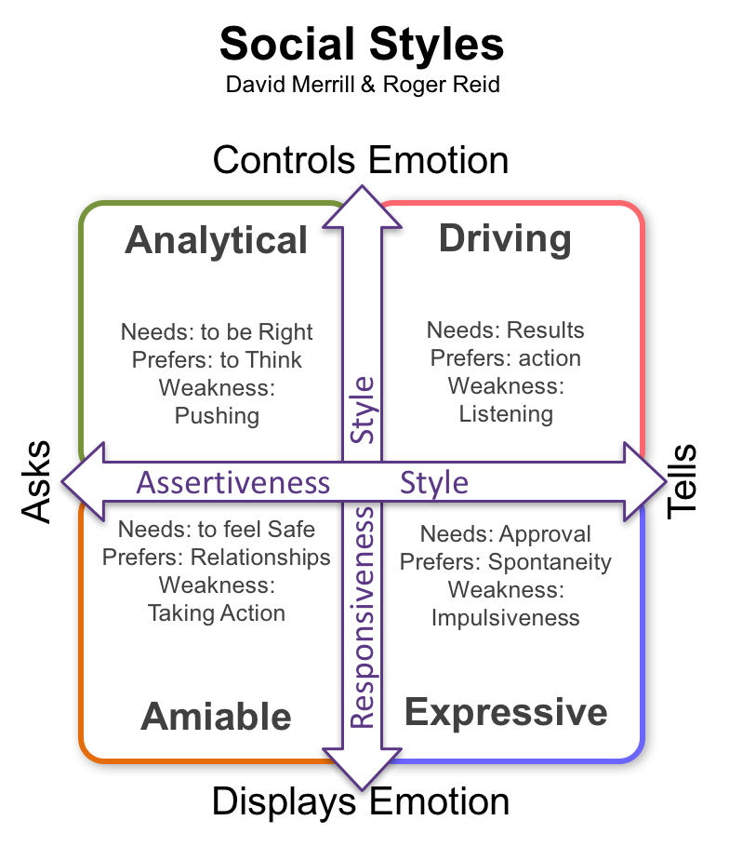
Merrill and Reid
Analytical
Driving
Amiable
Expressive
Notes:
DAVID MERRILL & ROGER REID: SOCIAL STYLES
Social Styles form a model of personality that focuses on our outer behaviour, rather than the inner you. Its founders described it as ‘the you that’s on display’.
In the early 1960s, two industrial psychologists, David Merrill and Roger Reid wanted to understand whether they could predict managerial, leadership and sales performance. To do this, they explored how people behave in social situations. They chose not to concern themselves with why.
Assertiveness and Responsiveness
Assertiveness styles range from ‘asking’ behaviours to ‘telling’ behaviours, while our responsiveness varies from ’emoting’, or displaying our feelings, to ‘controlling’ our emotions.
From these two dimensions, they defined four behavioural styles that we each display. As with other models, we each have our preferences, but can display all of the styles from time to time.
The value of the model lies in using it to assess the people around you, and knowing how to get the best from people with each preference.
Merrill and Reid labelled our ability to adapt to other people’s styles as ‘versatility’.

Slide 32
Merrill and Reid
The four quadrants that the two dimensions of assertiveness and responsiveness create, give the four social styles.
Analytical
The analytical style of interaction asserts itself by asking, rather than telling. It is also characterised by a high level of emotional control. It values facts, logic and accuracy, presenting a disciplined and unemotional – some would say cold – face to the world. This manifests in a deep need to be right about things, and therefore a highly deliberative, data-driven approach to decisions. As with all styles, there is a weakness, which is a lack of willingness to state a position until the analytical person is certain of their ground.
Driving
The driving style is the typical task-oriented behaviour that prefers to tell rather than ask and shows little concern for feelings. It cares more about results. This is a fast-paced style, keen to make decisions, take power, and exert control. Often unco-operative, this is an efficient, results-driven behaviour, the inevitable compromise of which is to sacrifice personal relationships in the short term and, in extremis, in the long term too. The weakness of this style is evident: a frequent unwillingness to listen and accommodate the needs of others.

Slide 33
Merrill and Reid
Expressive
The expressive style is also assertive, but uses feelings to achieve its objectives. The behaviour is highly spontaneous and demands recognition and approval, and favours gut instinct in decision-making. At its best, this style comes across as charismatic, enthusiastic and idealistic. At its worst, however, the expressive style can be seen as impulsive, shallow and even manipulative.
Amiable
The amiable style expresses concern for people above all else. Keen to share emotion and not to assert itself over others, building and maintaining relationships dominate behaviour. These concerns manifest a slow, deliberate pace, coming across as sensitive, supportive and dependable. The corollary is a certain nervousness about, and even a resistance to, change. This arises from a deep need for personal security. The weaknesses of this style are the reverse of the strengths of the opposite quadrant: a low willingness to initiate change, and take action.

Slide 34

Berne’s Transactional Analysis
In the 1950s Eric Berne began to develop his theories of Transactional Analysis. He said that verbal communication, particularly face-to-face, is at the centre of human social relationships and psychoanalysis. His starting point was that when two people encounter each other, one of them will speak to the other.

Slide 35
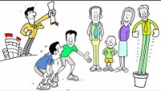

Slide 36
4 Fundamentals of leadership?
Self-Awareness
Communication
Influence
Learning agility
Notes:
These are the fundamental leadership skills needed by leaders at every organisation, regardless of role, industry, or location

Slide 37

What Do I Bring to Leadership?
What unique gifts do you brings to leadership?
Notes:
If your brave ask your team or people that know you well to give you feedback on your leadership?

Slide 38
Being an effective leader begins with YOU
Being self-aware
Being aware of the impact you have on others
Knowing what really matters to you
Behaving in alignment with your core purpose and values
Expressing yourself authentically
Notes:
Being Self Aware – knowing who you are: acknowledging your preferences and capabilities.
Being aware of the impact you have on others – recognising the influence you hold and noticing how others respond to you and your actions.
Knowing what really matters to you – enabling you to make decisions based on critical priorities rather than being pulled off course by other issues.
Behaving in alignment with your core purpose and values – ensuring that your actions are a direct reflection of your words.
Expressing yourself authentically – being really honest about what is important to you and being prepared to take a stand on it.

Slide 39

Activity:
Think about managers and leaders that you have met and seen in action. This can be at work, in a previous job, in a business that you know, or from a relevant TV programme or movie you have seen. Make a few notes about their leadership style and how you would feel (or do feel) working for them.
Points to consider could include:
your motivation; your confidence; your willingness to engage and contribute ideas and suggestions; respect for the manager and confidence in their ability to lead.
Notes:
Knowledge Activity 1:
Think about managers and leaders that you have met and seen in action. This can be at work, in a previous job, in a business that you know, or from a relevant TV programme or movie you have seen. Make a few notes about their leadership style and how you would feel (or do feel) working for them.
Points to consider could include:
your motivation; your confidence; your willingness to engage and contribute ideas and suggestions; respect for the manager and confidence in their ability to lead.

Slide 40
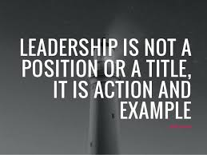

Slide 41

Ken Blanchard once said….
“EFFECTIVE LEADERS
MOVE
PEOPLE FROM DEPENDENCE
TO INDEPENDENCE”

Slide 42
Recruitment and performance management support success

Slide 43
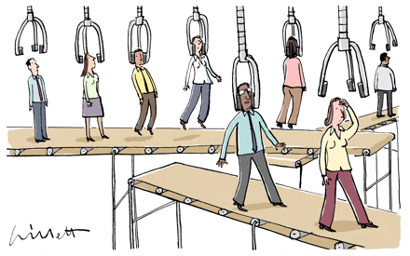
Job Descriptions
Job title
Reports to
Job Purpose
Organisation Chart
Dimensions
Principal Accountabilities
Planning and Organising
Decision Making
Internal and External relationships
Knowledge, Skills, experience needed
Special features
Notes:
You will have considered the options, full time, part time, temporary contracts etc

Slide 44
Person Specification
Detailed description of personal attributes required for the job
Skills
Experience
– quality and relevance
NOT number of years
Personal Qualities

Slide 45
Person Specification
Essential
candidates must possess
Highly numerate
Good PC skills with knowledge of spreadsheets
Experience of Accounts Payable processes
Good team working skills
Desirable
ideally candidates will possess
A working knowledge of SAP (company specific) software

Slide 46
INITIAL SIFT - SHORTLISTING
Remove personal details
Read every application
Match against job description
Match against person specification
Consider an assessment and scoring matrix
Draw up short list
At least 2 managers involved

Slide 47
INITIAL SIFT - SHORTLISTING
What can you use?
CV (?)
Application form
Covering letter

Slide 48
INITIAL SIFT - SHORTLISTING
Criteria
Salary expectations
Relevant experience (?) / Skills
Qualifications

Slide 49

Selection Tools
Interviews
Ability tests
Personality Questionnaires
Tests – Dexterity
Exercises – proof reading, typing etc
Competency questions
Presentations
Role-plays
NB:
Link to Person
Specification

Slide 50
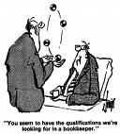
“YOU SEEM TO HAVE THE QUALIFICATIONS
WE’RE LOOKING FOR IN A BOOK KEEPER.”

Slide 51

What is Performance Management?
Notes:
Performance management (PM) is the process of ensuring that a set of activities and outputs meets an organization's goals in an effective and efficient manner. Performance management can focus on the performance of an organization, a department, an employee, or the processes in place to manage particular tasks.^{[1]} Performance management standards are generally organized and disseminated by senior leadership at an organization and by task owners, it can include specifying tasks and outcomes of a job, providing timely feedback and coaching, comparing employee's actual performance and behaviours with desired performance and behaviours, instituting rewards, etc.^{[2]}
In this context we will consider the employee

Slide 52
Group Discussion
What are the benefits of managing performance to:
Company, Individuals/Team/Customer/You
What are the Processes to help you effectively manage performance what are the Skills needed to manage performance effectively?
15 minutes
Elect a spokesperson

Slide 53
Performance Management
Was
An annual event
Assessment only
Superficial evaluation of personality
Loosely linked to business cycle
Superficial objectives
Now
A Continuous process
Assessment and Development
Specific evaluation of behaviour
Closely related to the business plan
Specific objectives

Slide 54
WHO BENEFITS AND HOW
Individual/Team
Discuss Future development
Gain feedback
Development
Feel valued
Motivated
Clarification of roles/objectives/standards
Recognition
Focused
You
Feedback / ideas
Gain support
Focus effort
Agree objectives, standards
Meet objectives
Company
Better performance
Corporate vision/objectives communicated
Identify potential
Identify corporate development needs
Maximise training expenditure
Good image
Meet objectives
Customer
Confidence in service
Quality product/service
Value

Slide 55
Skills to Manage Performance
objective setting
delegating
coaching / communication
dealing with poor performance
motivation
leading by example
questioning
listening
organising
Notes:
Quickly Review Coaching Models

Slide 56
Management Tools - Appraisal
90 Degree
180 Degree
270 Degree
360 Degree
720 Degree
Notes:
Formal Feedback – from a manager
Informal Feedback – from colleagues or customers
Learning activities
Development activities
Surveys
Discuss Feedback loops 180 – 720 degree:
90 Degree
This is the most basic form of appraisal. The appraiser/manager gives their evaluation of the employee. There is no self-evaluation. It’s one way and top down.
180 Degree
A 180 degree appraisal process involves the appraisee completing a self-evaluation form. The employee rates him/herself and gives feedback on their own performance. The self-appraisal is discussed and agreed with the appraiser during an appraisal review meeting. Once the information is agreed by both the appraiser and appraisee the appraisal is signed off.
270 Degree
The 270 Degree appraisal adds one more dimension and involves 3 groups of people: The appraiser/manager, the appraisee (self-appraisal) plus feedback gathered from peers or subordinates.
360 Degree
A 360 degree appraisal involves 4 groups of people. The appraiser/manager, the appraisee (self-appraisal) plus feedback gathered from peers and subordinates or customers/clients.
540 Degree
A 540 degree appraisal adds an external element as feedback is also collected from customers or clients. It has 5 dimensions: appraiser/manager, the appraisee (self-appraisal), peers, subordinates and customer/clients.
720 Degree
A 720 degree appraisal is basically a 360 degree appraisal performed twice. A second 360 degree is performed at a timely interval and compared against the results of the first 360 degree appraisal.

Slide 57
Talent management models
Here is a definition of ‘talent’ from the online business dictionary:
‘A natural ability to excel at a duty or action…A group of people, such as employees, who have a particular aptitude for certain tasks.’
Here is the definition of ‘talent management’:
‘An organisation’s attempt to recruit, keep and train the most gifted and highest quality staff members that they can find, afford and hire. Talent management gives business managers an especially important role to play in recruiting, developing and retaining desirable staff members.’
Notes:
Talent management is the process of recruiting, retaining and developing the best people
possible both now and for the future. It is closely linked to succession planning which is where
organisations seek to protect their operations through ensuring a continual pipeline of people
who can take up posts in the event of people leaving.

Slide 58
Approaches to talent management
Ram Charan, Stephen Drotter and James Noel’s Leadership Pipeline
The six leadership passages in their model are:
1. Managing self to managing others
2. Managing others to managing managers
3. Managing managers to functional managers
4. Functional manager to business manager
5. Business manager to group manager
6. Group manager to enterprise manager
Notes:
From their book The Leadership Pipeline – How to Build the Leadership Powered Company,
messrs Charan, Drotter and Noel offer us six leadership ‘passages’ a manager must work their way
through. According to this model, organisations, in order to keep the pipeline full, must embed
development opportunities at all of these passages.

Slide 59
Talent management models
1. Managing self to managing others – the turning point from managing self to managing others is when the individual gets their first promotion to a management position. The challenge for the individual then is to make the transition from an individual contributor to developing others’ ability to contribute.
2. Managing others to managing managers – the individual’s first management promotion, as described above, tends to be a mixture of managing others but still retaining some individual contribution to the work of the team. At this turning point however they need to step away from tasks and move to a coaching style of management that supports the development of other managers.
3. Managing managers to functional managers – managers at this level have two levels of managers underneath them and will find themselves accountable for work in which they are not an expert. Delegation is key to success at this level as they manage the needs of the larger organisation as well as the challenges of the functions they are accountable for.

Slide 60
Talent management models
4. Functional manager to business manager – the shift here is to strategic management so that the different functions synergise in order to maintain sustainable levels of profit for their part of the business.
5. Business manager to group manager – group managers focus on the success of all the businesses in the organisation. They are responsible for broader factors such as resource allocation, group portfolio strategy, mergers, acquisitions, which markets to enter and leave. At this level external environmental factors such as politics, society, economics, legal issues, the environment, ethics and technical challenges will be at the fore. Where the organisation is publicly owned they may have responsibilities to shareholders and financial institutions.
6. Group manager to enterprise manager – skills are no longer the manager’s focus. This is now on values, vision and taking a longer-term view. There is a move away from strategic thinking to being visionary and having a global perspective.

Slide 61
Talent management models
Spotting Talent – Andy Cross
• High maintenance and low impact – is what Cross terms a mistake; people who drain your resources and provide little value for customers.
• High maintenance and high impact – the prima donna; these people may deliver great performance; however they do so at the expense of the good of the broader team.
• Low impact and low maintenance – the backbone, these people get on with their work without fuss but are unlikely to lead and drive innovation and change.
• High impact and low maintenance – these people, according to Cross are the real deal; they get results and can drive innovation and change. They are low maintenance because they deliver performance and have a positive impact on those around them.
Notes:
This very simple model is from Andy Cross’s Talent Management Pocketbook (2016) and provides
a framework for identifying talent in our teams.
The two factors that guide this model are maintenance and impact. These both have scales from
high to low creating the following categories of talent: Reveal in turn.

Slide 62
Talent management models
Bersin’s Talent Management Maturity Model
According to the maturity model offered by Bersin there are four levels of increasing integration (what Bersin terms ‘maturity’) in relation to talent management. These are:
1. Essential talent activities
• At this level of maturity organisations work with talent via performance management but do not have a predetermined approach or strategy to identifying and retaining talent.
• Organisations may appreciate the need for talent management but lack the understanding
of what it is and what needs to be done.
• Any talent management activity that is undertaken is done without coordination and may
occur separately and differently in different organisational functions.

Slide 63
Talent management models
Bersin’s Talent Management Maturity Model
2. Critical talent growth
• At this level there may be development or even implementation of a talent strategy linked to training activities that support it.
• This strategy may be integrated across key business functions (such as marketing/finance/
HR/operations).

Slide 64
Talent management models
Bersin’s Talent Management Maturity Model
3. Managed talent relationships
• At this level organisations have a clear and integrated talent strategy supported by
targeted development activities in leadership and learning.
• The culture in the organisation drives talent development and is categorised as being one
driven by learning.
• The organisation also has a highly developed ability to analyse its workforce to ensure
talent is developed at every opportunity.

Slide 65
Talent management models
Bersin’s Talent Management Maturity Model
4. Inclusive talent system
• Here there are clear, fully integrated, targets and a developed talent strategy.
• The strategy is integrated into the organisation’s strategic activities and forms part of the
business drivers.
• The strategy ensures that talent management is bespoke to the needs of the different parts
of the business whilst retaining relevance for the whole organisation.

Slide 66
Talent management models
Berger and Berger’s Building Blocks for Creating a Talent Management Programme
The Misfit:
this person not achieving the organisation’s minimum requirements. They make up
only a small part of the workforce and allocation of training to this group is limited to maintaining their current position.
The Solid Citizen:
similar to Cross’s backbone, they form a majority of the workforce and meet
the organisation’s standards, want to do a good days work and do so consistently but are not
interested in career paths. Investment in training and development for this group is in response to the needs of the work to maintain levels of performance.
Notes:
In Lance and Dorothy Berger’s (2011) The Talent Management Handbook they offer four employee
classifications indicating their future potential and therefore the allocation of training and
development resources. These classifications are:

Slide 67
Talent management models
Berger and Berger’s Building Blocks for Creating a Talent Management Programme
The Keeper:
this person exceeds the organisation’s requirements and is likely to continue to do so in the future and therefore investment in these individuals will be high and the speed of development will be rapid.
The Superkeeper™:
this person outperforms all of the others and vastly exceeds the organisation’s expectations. These people will receive high levels of investment in training and development, will move at a high speed through the organisation and do so with a high profile.

Slide 68
Talent management models
Berger and Berger’s Building Blocks for Creating a Talent Management Programme
Block 1 – Competency assessment
In this block the focus is on assessing individuals’ abilities, skills, competencies and behaviours. These include self-awareness, social awareness, the ability to self-manage, and how well individuals
manage relationships.
Block 2 – Performance appraisals
This block is about ensuring the organisation has a comprehensive performance and appraisal
management process that covers both achieving results and using the right behaviours. This would
include providing effective reviews and feedback.
Block 3 – Succession and career planning
This block blends the organisation’s need to have a plan that secures talent for future key positions with enabling people to define their own desires and aspirations. This requires developing a plan that, much like Bersin’s stages 3 and 4, is fully integrated and aligned with organisational strategy.
Notes:
The three building blocks to creating an effective talent management programme, according to
Berger and Berger, are briefly summarised here:

Slide 69
Meeting organisational objectives through talent management
There are clear links between successful talent management planning and the achievement of an organisation’s objectives in the different models and approaches previously described, such as:
Managing a talent pipeline
Linking succession planning with career planning
Identifying high-potential employees
Considering talent as part of overall business strategy
Assessing competencies
Notes:
Managing a talent pipeline – this ensures the organisation has a continual supply of talented
individuals working their way up through the ranks and at every transition there is support and
development so that each stage is successfully navigated.
Linking succession planning with career planning – organisations need to ensure they have
a sustainable pipeline of people in place who can step up to new positions when they become
available. This also ensures that employees are able to succeed in their career aspirations and
needs and do not feel the urge to go elsewhere to achieve these.
Identifying high-potential employees – creating processes that allow managers to spot talent when
it presents itself, classify it and then to use the talent system in place to identify a suitable career
path. These processes will also enable the correct training and development to be put in place.
Considering talent as part of overall business strategy – to remain competitive, organisations
will need to attract the right talent to their ranks. They will also need to retain and develop them.
The strategic plan should therefore support the work done to attract and retain talent, allocate
appropriate resources and create the right environment and culture to sustain it.
Assessing competencies – organisations need to create competency models, frameworks and
processes that allow them to define what skills, behaviours, attitudes and abilities they need
people to demonstrate and apply to succeed. They then need to identify these people in their
workforce so that talented individuals can be targeted for development.

Slide 70

It has been said:
“You cannot teach a man anything, you can only help him to learn.”
“Give a man a fish, and you feed him for a day. Teach a man to fish, and you feed him for life.”

Slide 71

The role of coaching in the workplace
Notes:
Introduction
There are differences between training and coaching. Generally speaking, training is driven by the trainer who controls the process and the content of the sessions. It focuses on learning and often takes place in groups. Training is useful when team leaders and managers need to teach specific skills or knowledge.
Coaching, on the other hand, is a two-way process where the team member takes an active part and the coach acts as a facilitator. It focuses on development and is usually done on a one-to-one basis, although it can be used for small groups or teams.
In your workbooks this section, we will look at:
• the benefits of coaching
• coaching techniques and models
• the manager’s coaching skills
• how coaching can be used to improve performance in the workplace

Slide 72

KEY SKILLS OF A COACH
Demonstration
Explanation
Giving Feedback
Empathy
Question Technique
Listening Skills
Body Language

Slide 73
COACHING AND TRAINING
Coaching
On job
More informal
Practical based
1:1
Corrective or Improvement
Training
Off job
More structured / Formal
Practical and/or theoretical
Set objectives
Formal
1:1 or group
New skills

Slide 74
Mentoring | Coaching
Ongoing relationship that can last for a long period of time | Relationship generally has a set duration
Can be more informal and meetings can take place as and when the mentee needs some advice, guidance or support | Generally more structured in nature and meetings are scheduled on a regular basis
More long-term and takes a broader view of the person | Short-term (sometimes time-bounded) and focused on specific development areas/issues
Mentor is usually more experienced and qualified than the ‘mentee’. Often a senior person in the organisation who can pass on knowledge, experience and open doors to otherwise out-of-reach opportunities | Coaching is generally not performed on the basis that the coach needs to have direct experience of their client’s formal occupational role, unless the coaching is specific and skills-focused
Focus is on career and personal development | Focus is generally on development/issues at work
Agenda is set by the mentee, with the mentor providing support and guidance to prepare them for future roles | The agenda is focused on achieving specific, immediate goals
Mentoring revolves more around developing the mentee professional's career | Coaching revolves more around specific development areas/issues
Brefi group

Slide 75

What is Coaching?
“A structured, two-way process in which individuals develop skills and achieve defined competencies through assessment, guided
practical experience and regular feedback”

Slide 76
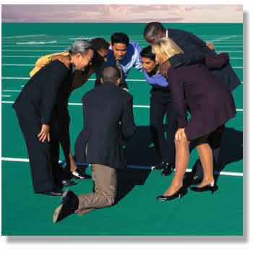
When to Coach?
Not meeting standard
New policies/procedures
New staff
Delegate extra tasks
Individual requests new task
Individual needs motivating
Notes:
Revise the models:
GROW, ARROW, OSCAR, STAR etc

Slide 77
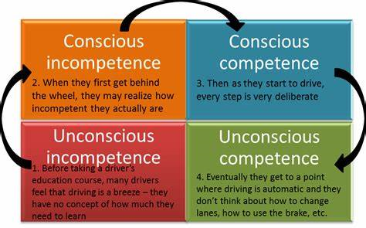
LEARNING NEW TASK
Notes:
Unconscious competence - The person must become conscious of their incompetence before development of the new skill or learning can begin.
Conscious incompetence - The person ideally makes a commitment to learn and practice the new skill, and to move to the 'conscious competence' stage.
Conscious competence - The person will need to concentrate and think in order to perform the skill.
Unconscious competence - The person might now be able to teach others in the skill concerned, although after some time of being unconsciously competent the person might actually have difficulty in explaining exactly how they do it – the skill has become largely instinctual.
For me I was
Unconsciously incompetent at completing my tax return – I thought it would be easy.
Then I tried and I realised that I was consciously incompetent at doing it.
I never got to consciously competent as I found it a lot easier to get an accountant and she is unconsciously competent at it so that seemed like a much better plan.
I am consciously competent when it comes to cooking a new meal. I learned to cook in restaurants so it is something that I know I can do but when it is a new dish I have to focus more on what I am doing.
I am unconsciously competent at nagging my husband – I can honestly do it without even thinking about it now and often find myself doing it without realising.
Ok so who would like to learn a new skill.

Slide 78
LEARNING NEW TASK
UNCONSCIOUS INCOMPETENCE
CONSCIOUS INCOMPETENCE
CONSCIOUS COMPETENCE
UNCONSCIOUS COMPETENCE

Slide 79
GROW MODEL
GOAL – establishing the goal
REALITY – examining the current reality
OPTIONS – exploring the options
Will – establish the will to go forward
Notes:
There are many different coaching techniques and a well-known one is the GROW model.
It was developed in the 1980s by performance coach, John Whitmore, and has been developed since then by others, including Alan Fine and Graham Alexander.
The elements
of the GROW model are Goal, Reality, Options and Will:
Goal – establishing the goal
Q – How do we approach this? (Discuss)
Answers:
• looking at the element that needs to be changed – e.g. behaviour, performance level or skills gap
• turning it into a goal that the individual wants to achieve
• establishing and agreeing SMART targets (Specific, Measurable, Achievable, Realistic and Time bound)
• ensuring that the goal fits in with the personal, team and organisational objectives
Reality – examining the current reality
Q – How do we approach this? (Discuss)
Answers:
• asking the team member to describe their current reality to establish and understand the starting point
• examining steps that have already been taken and evaluating the outcomes
• checking that the goal does not conflict with other current objectives and demands on the individual’s time and capacity
Options – exploring the options
Q – How do we approach this? (Discuss)
Answers:
• discussing the different options to determine what is possible
• brainstorming as many options as possible
• looking at what else can be done to remove barriers or constraints that have prevented progress so far
• comparing advantages and disadvantages
• developing effective strategies and behaviours that achieve success
Will – establishing the will to go forward
Q – How do we approach this? (Discuss)
Answers:
• committing to the process – the individual now has a good idea about how to achieve the goals and now needs to commit to the process by working out the ‘how, why, where, what and when’
• preparing for change – mentally and practically
• considering what may stop progress and how obstacles will be overcome
• looking at how to stay motivated
• working out how and when to review and track progress – to encourage accountability and allow original plans to be adjusted if necessary
When using this coaching model, it is important to remember that the team leader or manager is the facilitator and not the advisor. The idea is that the manager helps the individual to find their way and select the best options, but does not offer advice or direction.
When developing and delivering a coaching plan, team leaders and managers need to find and use techniques that will stretch individuals and help them to fulfil their potential.
Q What coaching techniques support the GROW model?
Answer:
Coaching techniques that support the GROW model
• psychometric and development tests
• one-to-one sessions and structured interviews
• mini projects
• role play
• video training sessions
• workplace training sessions, workshops and demonstrations
• reading and study materials
There is additional details about all of these in your workbook.

Slide 80
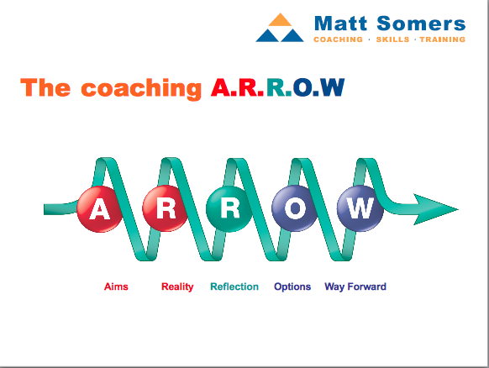

ARROW MODEL
Notes:
Other techniques use different headings but follow similar ideas and principles. One is known as
ARROW. This includes reflection as part of the process and was developed by Matt Somers. It
stands for:
Aims
Reality
Reflection
Opportunities
Ways forward

Slide 81
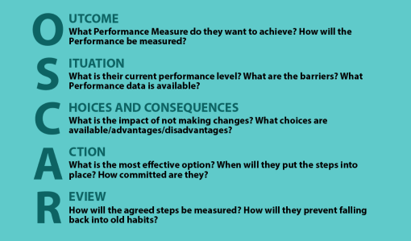
Notes:
The OSCAR coaching model was developed by Andrew Gilbert and Karen Whittleworth. It builds on and enhances the GROW model. The steps of the OSCAR model are:
Outcome - helping the team member to clarify their outcomes
Situation - where the team member is right now
Choices and consequences - helping the team member to generate as many choices as possible,
whilst raising awareness of consequences of each choice
Action - supporting the team member as they clarify the action they will take
Review - an ongoing review process to help the team member stay on track

Slide 82
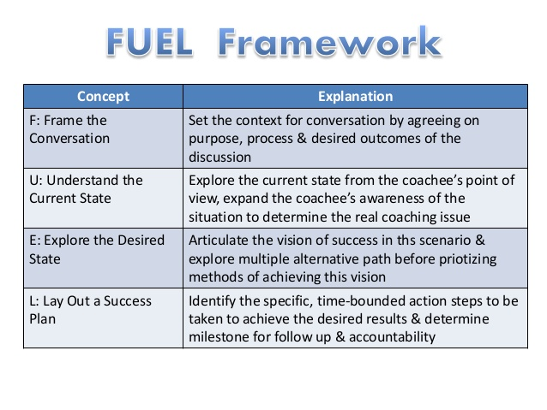
F
U
E
L
Notes:
The FUEL coaching model is also used. The framework was developed by John Zenger and Kathleen Stinnett and stands for:
Frame the conversation
Understand the current state
Explore the desired state
Lay out a success plan

Slide 83

STRUCTURE OF A 1:1 SESSION
BEGINNING
Agree the learning need
Relax the individual
State the benefits of learning
WHAT / INTEREST / NEED
Notes:
Ok what did I do to agree the learning?
Your first task will be to learn to make a Lotus flower from a serviette to be used in our A-la carte restaurant.
The first learning today is going to be learning to make a lotus flower with a serviette. Ok? Any questions?
Happy with what we are doing, why we are doing it and what we need to achieve?
What did I say to relax the Individual?
Don’t worry, I know this is new for you so we will go at a speed that you are comfortable with, ok?
Do you have any questions before we start?
Ok, if you are uncertain or have questions as we are going through then please let me know straight away, you don’t have to wait for me to ask you if you have any questions. Ok?
What did I do to state the benefits of learning?
Once you have learnt it, you will never forget and it gets easier with a little practice.
I always get a great sense of achievement looking around the restaurant and seeing how uniformed and pretty they look.
What did I state was the WIN (What / Interest / Need)
What - Ok I am going to go through the steps with you so you can make the flower.
Interest - I am going to break them down for you. First I will show you what to do, then I will make sure you don’t have any questions, then I will watch you try
Need then I will check your understanding both verbally and practically as I need to be sure that you know what to do, how to do it and why we do it.

Slide 84
STRUCTURE OF A 1:1 SESSION
MIDDLE
Demonstrate and/or explain stages
Trainee Practises
Questions
Praise and feedback
Notes:
Did you see all of the middle stages?

Slide 85
STRUCTURE OF A 1:1 SESSION
END
Check understanding - both verbal and practical
Offer support
Link forward
Praise
Notes:
How did I check understanding both Verbal and practical?
Checking throughout and then at the end
13. Verbal check - Ok talk me through the whole process and I will answer any questions you have
When talked through any questions?
Is there anything you want me to show you or explain to you again?
Practical check - Ok now make one from start to finish
How did I offer support?
Is there anything you want me to show you or explain to you again?
How did I link forward and praise at the end?
Praise – Link forward – once you have mastered this there are lots of other designs that we can teach you – Praise

Slide 86

Monitoring progress
Notes:
SMART objectives help us to monitor progress against the targets mapped out in the PDP.
Progress needs to be monitored so that we can, for example:
• assess progress against specific targets – to measure development – e.g. looking at dates for handing in assignments and seeing if they are on time
• adjust elements of objectives – to keep them achievable and realistic – e.g. changing timescales following illness
• allocate or seek additional resources – e.g. arranging for one-to-one tuition to learn a language needed for work on time for a newly signed project
• agree further development activities – e.g. work tasks have been done early and there is scope to help out in a different department for a few days
The PDP needs to be monitored regularly to keep things on track so that problems do not get out of hand. If everything is going well, the positive feedback will be a boost and help to motivate the employee to carry on. If there are problems, it is vital to catch them early so that they can be dealt
with quickly and keep the rest of the PDP intact.
Monitoring can be quite informal because it is really keeping an eye on the smaller elements and details of the PDP.

Slide 87
SMART Targets
Specific – details about what exactly needs to be achieved
Measurable – this could be the number of units to be covered, or the time limit
Achievable – the task needs to be possible for the individual
Realistic – the target and limits set need to be realistic
Time-bound – the deadline for achieving the target or completing the task
Notes:
Once areas for personal development have been identified, it is important to set targets.
By having our goals and objectives clearly in mind, there is a much greater chance of success.
One good way to set goals is to use SMART objectives:
Do you know what SMART Targets are? Do you use them?
X -
S Specific – details about what exactly needs to be achieved
M Measurable – this could be the number of units to be covered, or the time limit
A Achievable – the task needs to be possible for the individual
R Realistic – the target and limits set need to be realistic
T Time-bound – the deadline for achieving the target or completing the task
Q - Ok so when completing our personal SMART Targets, what questions can we ask ourselves?
Firstly for specific? (Discuss as group, some examples below)
Specific - What are the details of the learning activity, task or training course that I want to do? What qualifications do I need for that promotion? Which job am I aiming for?
Next for Measurable? (Discuss as group, some examples below)
Is there a certificate or report that can show my progress? Can I count the number of units I am covering so that I can see my progress?
Next for Achievable? (Discuss as group, some examples below)
Can I do it? What support do I need to find to make sure that I can achieve these goals?
Next for Realistic? (Discuss as group, some examples below)
Is it realistic to do the training or tasks in the time that is allowed? Is it realistic to work full time and do all of this study quickly, or do I need to study over a longer period of time?
And lastly for Time bound? (Discuss as group, some examples below)
What are the deadlines? Do I need to have completed this task before my tutor comes next time, or in time for my annual review?

Slide 88
Mentoring
The purpose of mentoring is to tap into the existing knowledge, skills, and experience of senior or high performing employees and transfer these skills to newer or less experienced employees in order to advance their careers
Mentoring can be used for a wide variety of situations and different points in someone’s working life for example:
• Induction for a new starter*
.• Individuals working towards promotion.
• Staff who have changed roles in the department or across the organisation
.• Staff on structured learning programmes for example ILM programmes.
• Changes to job roles for example following a restructure.
• Continuous Professional Development (CPD).
Notes:
Ask why do we mentor?

Slide 89
Mentoring
The mentoring relationship should be based on trust, confidentiality, mutual respect and sensitivity. The relationship should be based on agreed boundaries and ground rules that address the power differentials between the mentor and mentee.
Successful mentoring relationships go through four phases: preparation, negotiating, enabling growth, and closure. These sequential phases build on each other and vary in length

Slide 90
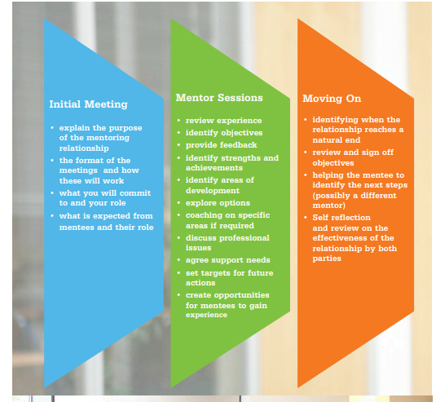
Mentoring Process

Slide 91
Team Development – Bruce Tuckman
PERFORMANCE
A
D
J
O
U
R
N
I
N
G
FORMING STORMING
NORMING PERFORMING
STAGES OF DEVELOPMENT
Notes:
Forming – members of a team come together but are unclear about direction and their roles in
the team. The manager needs to provide a clear mission and objectives and communicate these
to the team members.
Storming – as team members start to establish themselves in their roles there can be conflict and
friction as new ideas are tried out and people vie for position and power. This can be a messy
stage as people jostle to find their place in the team.
Norming – the beginning of cooperation and working together follows as initial success is
experienced and people begin to appreciate each other for what they bring to the team.
Confidence increases because of the success and trust starts to emerge.
Performing – the team is now performing and able to work openly and collaboratively. High
levels of trust now exist, the needs of the team come first. The team is successful and celebrates
it success together.
There are clear implications for the manager as to which approach they might take at each of the
stages, such as:
• Forming – the manager will need to provide clear direction about the team’s and each team
member’s purpose and objectives. The manager may need to influence and reassure team
members but keep tight control and retain the final say over decisions. This will involve:
– setting clear goals and objectives
– training and instruction
– providing clear instructions
– regular check-ins and updates
– closely supervising the work
• Storming – in this more challenging stage team members may become frustrated and the quality
of work will vary. Managers will need to encourage team members to work together and contribute
ideas to decision-making and problem-solving. This will require diplomacy and compromise from
the manager, whilst still retaining control of most of the final decisions. This will involve:
– reaffirming goals and objectives
– explaining the bigger picture
– asking team members for suggestions
– providing encouragement and support
– acknowledging and addressing concerns
• Norming – to reach this stage the manager will have to work hard in the previous two stages.
However the team now shows signs of working. Team members have become more accepting
of each other. Important decisions are now made collectively and trust and commitment is much
stronger. The manager can allow the team to find its own way with tasks but may still need to
provide support and help develop confidence further. This will involve:
– focusing on support needs of team members
– listening and asking questions
– asking team members to develop their own solutions
– increased delegation of tasks
• Performing – the team members are now working together and have common purpose. The
manager can largely let the team do its work and provides support on training, rewards, strategy
and structure; the team knows what to do but can request help where needed. This will involve:
– lower levels of input from the manager
– higher levels of task delegation
– allowing team members to get on with the work
– developing team members into mentors and experts

Slide 92

Activity
In your group
Discuss what you, as a Manager, can do to move a team from
Forming to Storming
Storming to Norming
Norming to Performing
15 mins

Slide 93
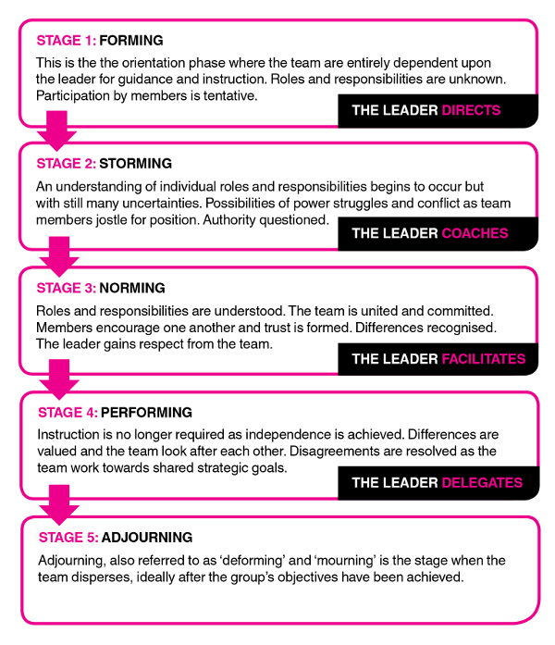
Team Development Bruce Tuckman

Slide 94


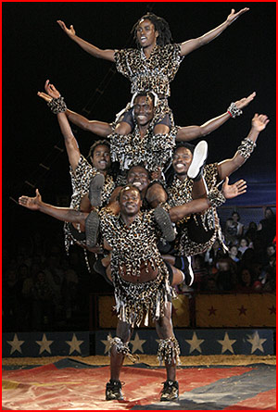
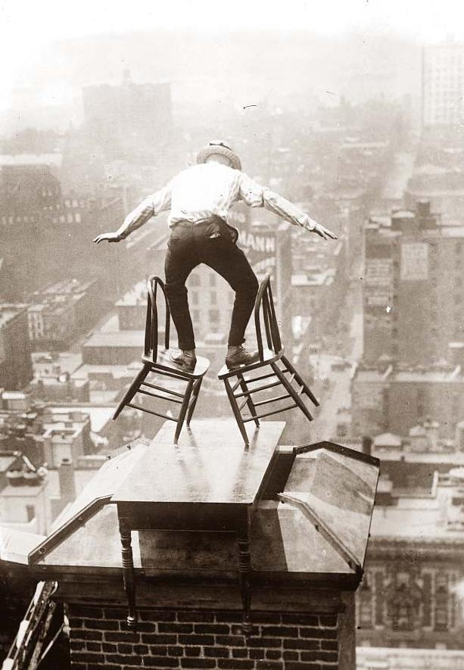
In 1981 Belbin said ….
“TEAMS ARE A QUESTION OF BALANCE
What is needed
is not
well balanced
individuals
but
individuals who
balance
well with
one another”

Slide 95

Belbin’s Team Roles – Research Activity
Plant
Resource Investigator
Co-Ordinator
Shaper
Monitor - Evaluator
Teamworker
Implementer
Completer - Finisher
Specialist

Slide 96
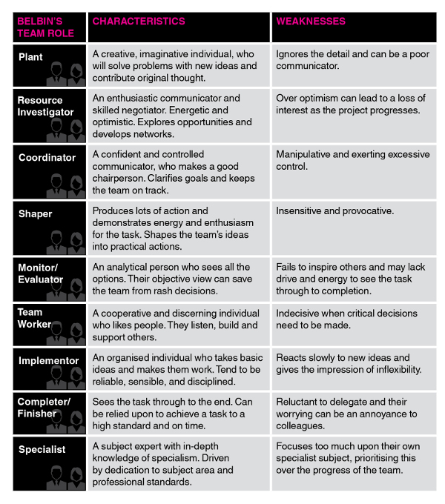
BELBIN’S
CHARACTERISTICS AND WEAKNESSES
Think about you and your team and given yours and their preferences:
How will you manage your individuals?
What do you need to consider about your preferences

Slide 97
Motivation
“The art of getting someone else to do something you want done because they want to do it”
Eisenhower

Slide 98
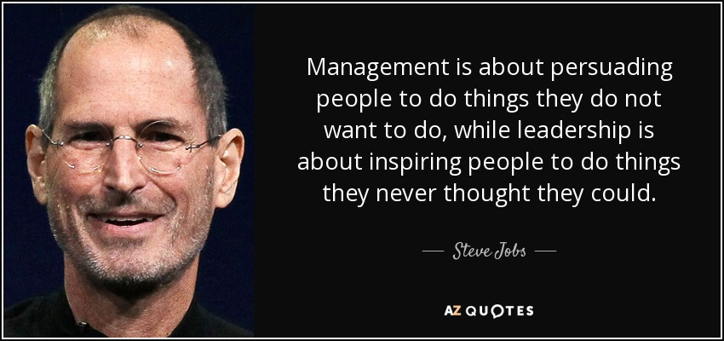

Slide 99
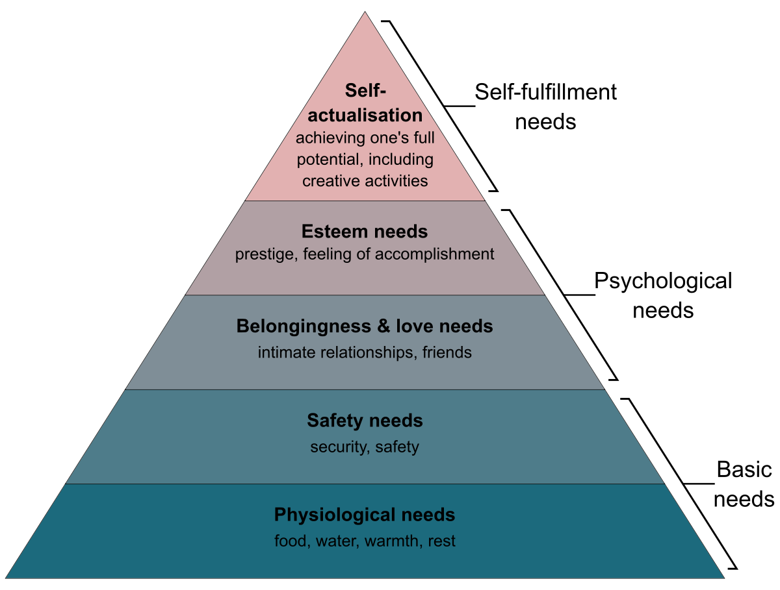
Maslow’s Hierarchy
Notes:
Maslow's hierarchy of needs is used to study how humans intrinsically partake in behavioral motivation. Maslow used the terms "physiological", "safety", "belonging and love", "social needs" or "esteem", and "self-actualization" to describe the pattern through which human motivations generally move. This means that in order for motivation to arise at the next stage, each stage must be satisfied within the individual themselves. Additionally, this theory is a main base in knowing how effort and motivation are correlated when discussing human behavior. Each of these individual levels contains a certain amount of internal sensation that must be met in order for an individual to complete their hierarchy.^{[3]} The goal in Maslow's theory is to attain the fifth level or stage: self-actualization.^{[4]}

Slide 100
Hertzberg’s Theory of Motivation
Factors for Satisfaction | Factors for Dissatisfaction
Achievement
Recognition
The work itself
Responsibility
Advancement
Growth
Company policies
Supervision
Relationship with supervisor and peers
Work conditions
Salary
Status
Security
Notes:
Hertzberg based his theory on 203 interviews with engineers and accountants in Pittsburg. He asked what pleased and what displeased them about their job and the answers were not surprising. The “please-factors” were things like: achievement, recognition, the work itself, responsibility, advancement and growth, while the “displease-factors” were things like: company policies, supervision, relationship with supervisor and peers, work conditions, salary, status and security.
Hertzberg then divided the motivational drivers into two groups: “hygiene factors” and “motivators”.
Hertzberg’s hygiene factors are things like: job security, salary, benefits, work conditions, good pay, paid insurance and vacations. In other words mainly extrinsic, short term motivation factors – things that other people do, or don’t do – or things that other people give you or don’t give you.
Opposite the hygiene factors, Hertzberg’s motivators are things like: challenging work, recognition for one’s achievement, responsibility, opportunity to do something meaningful, involvement in decision making and a sense of importance to an organization. Hertzberg’s motivators are mainly long-term, intrinsic motivation factors, things that come from inside, like feeling a part of something bigger than ourselves and understanding our individual contribution to the overall objectives.

Slide 101
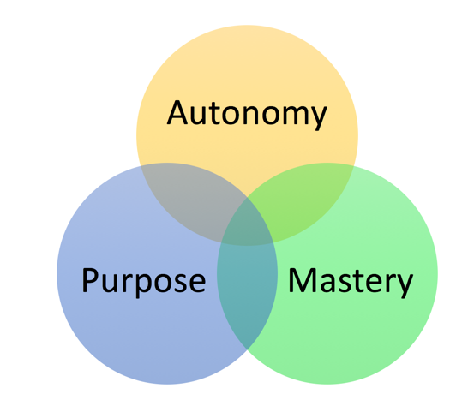
Daniel Pink - Motivation
Notes:
Daniel Pink is a modern writer on business & management, with a strong focus on the changing nature of work and the workplace. His book - Drive: the Surprising Truth About What Motivates Us - was published in 2009 and very quickly became a bestseller with its focus on the importance and effectiveness of three intrinsic elements to motivation at work: autonomy, mastery and purpose.
Pink argues that the evidence of scientific studies on motivation and rewards suggests that, for any work task that involves most than the most basic cognitive challenge, basic financial reward systems simply do not work. In fact, they can lead to worse performance.
For simple, straightforward tasks, Pink concedes that traditional financial rewards or a carrot & stick approach to motivation DO work. These can be considered as "external" methods of motivation. They are simple and they still work.
He accepts that money is a motivator at work, but once people perceive that they are paid fairly, then they become much more motivated by intrinsic elements. Once people are paid fairly, they look for more from their work.
A summary of Pink's key points on the three intrinsic elements of motivation is provided below.
Autonomy
According to Pink, autonomy is the desire to direct our own lives. Pink argues that allowing employees autonomy runs counter to the traditional view of management which wants employees to "comply" with what is required of them.
However, if managers want employees to be more engaged in what they are doing (and they should - as tasks become more complicated) then allowing employees autonomy (self-direction is better).
Pink provides some examples of what he means by autonomy, summarising them into four main aspects: time, technique, team and task
For example, some firms allow employees to have time at the workplace to do whatever they want. This freedom to spend time doing their own thing leads to many more innovative ideas and solutions. A good example is Google which has benefited from numerous product ideas as a result of allowing developers to pursue individual projects during work time.
The growth of flexible working practices is another good example of allowing staff more autonomy. For example, providing the technology and freedom to work from home.
Pink is an advocate of greater use of teamwork as a means of facilitating autonomy, particularly where the team members themselves pick the team!
Mastery
Pink describes mastery as the desire to continually improve at something that matters.
Pink argues that humans love to "get better at stuff" - they enjoy the satisfaction from personal achievement and progress. Allowing employees to enjoy a sense of progress at work contributes to their inner drive.
By contrast, a lack of opportunity at work for self-improvement or personal and professional development is liable to make employees more bored and demotivated
A key implication for managers to is to set tasks for employees that are neither too easy or excessively challenging. Pink calls such tasks "Goldilocks tasks) - ie. tasks that are not "too hot or too cold".
Goldilocks tasks push employees out of their comfort zones, and allow them to stretch themselves and develop their skills and experience further.
Purpose
Pink describes purpose as the desire to do things in service of something larger than ourselves. Pink argues that people intrinsically want to do things that matter.
For example, entrepreneurs are often intrinsically motivated to "make a difference" rather than simply aiming for profit maximisation.
Most of us spend more than half our working hours at work. We want that time to matter.
So a key part of adding purpose to work is to ensure that the mission and goals of the organisation are properly communicated to employees. Employees need to know and understand these, and appreciate how their work and role fits into what the organisation is about.
But don’t take my word for it………

Slide 102
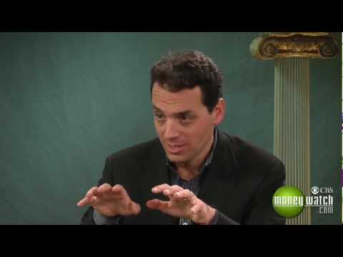
But Don't take My word For It......
https://youtu.be/feDJ3zL23qw
Notes:
Based on studies done at MIT and other universities,^{[4]} higher pay and bonuses resulted in better performance ONLY if the task consisted of basic, mechanical skills. It worked for problems with a defined set of steps and a single answer. If the task involved cognitive skills, decision-making, creativity, or higher-order thinking, higher pay resulted in lower performance. As a supervisor, you should pay employees enough that they are not focused on meeting basic needs and feel that they are being paid fairly. If you don’t pay people enough, they won’t be motivated. Pink suggests that you should pay enough “to take the issue of money off the table.”
To motivate employees who work beyond basic tasks, Pink argues that supporting employees in the following three areas will result in increased performance and satisfaction:
Autonomy — Our desire to be self directed. It increases engagement over compliance.
Mastery — The urge to get better skills.
Purpose — The desire to do something that has meaning and is important. Businesses that only focus on profits without valuing purpose will end up with poor customer service and unhappy employees.^{[5]}

Slide 103
McClelland's Human Motivation Theory
Achievement
Has a strong need to set and accomplish challenging goals.
Takes calculated risks to accomplish their goals.
Likes to receive regular feedback on their progress and achievements.
Often likes to work alone.
Notes:
Key Points
McClelland's Human Motivation Theory states that every person has one of three main driving motivators: the needs for achievement, affiliation, or power. These motivators are not inherent; we develop them through our culture and life experiences.
Achievers like to solve problems and achieve goals. Those with a strong need for affiliation don't like to stand out or take risk, and they value relationships above anything else. Those with a strong power motivator like to control others and be in charge.
You can use this information to lead, praise, and motivate your team more effectively, and to better structure your team's roles.

Slide 104
McClelland's Human Motivation Theory
Affiliation
Wants to belong to the Group
Wants to liked and will often go along with whatever the Group wants
Favours collaboration over competition
Doesn't like risk or uncertainty
Notes:
Those with a strong need for affiliation don't like to stand out or take risk, and they value relationships above anything else.

Slide 105
McClelland's Human Motivation Theory
Power
Wants to control and influence others.
Likes to win arguments.
Enjoys competition and winning.
Enjoys status and recognition.
Notes:
Those with a strong power motivator like to control others and be in charge.
You can use this information to lead, praise, and motivate your team more effectively, and to better structure your team's roles.

Slide 106
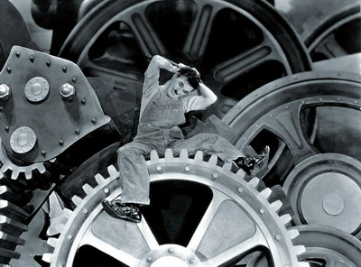
McGregor’s Theory on Motivation
THEORY X LEADERS - Base their actions on certain assumptions:
People have an inherent dislike of work and will avoid it if they can.
People must be coerced, controlled, directed and threatened to get them to put in adequate effort
People prefer to be directed, wish to avoid responsibility, have little ambition and want security above all else

Slide 107
McGregor’s Theory on Motivation
THEORY Y LEADERS - Base their actions on certain assumptions:
Physical and mental effort in work is natural
People will exercise self-direction and self control
People learn to seek and accept responsibility
The capacity for imagination, ingenuity and creativity is widely distributed in the population
Intellectual potential is only being partly utilised

Slide 108
Hackman and Oldham - High Job Motivation
The person….
……… feels their work is meaningful
….feels responsible for the outcome of the work
…….knows how they are performing

Slide 109

WHAT MAKES JOB MEANINGFUL?
SKILL VARIETY
CHALLENGING
VARIED
TASK IDENTITY
WHOLE NOT PART JOB
TASK SIGNIFICANCE
IMPACT OF JOB
Hackman and Oldham

Slide 110

What is Delegation?
“To pass authority NOT ultimate responsibility for doing something to someone else”

Slide 111
The Process of Delegation
Preparing to delegate
Decide what to delegate
Select team members
Carrying out the delegation
Set objectives
Review
Plan
Monitor
Implement

Slide 112
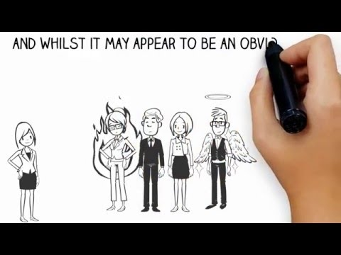

Slide 113
Delegating Decision-Making
1. CONDITIONAL
- check first
2. INFORMATIVE
- keep informed of the decisions
3. ABSOLUTE
- do as think best.

Slide 114
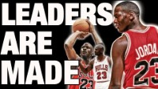

Slide 115
Unit 549 – Developing and Managing & Leading Teams
Learning Outcome 1 Understand approaches to developing, managing and leading teams
Learning Outcome 2 Understand approaches to achieving a balance of skills and experience in teams
Learning Outcome 3 Know techniques for leading individuals and teams to achieve success
Learning Outcome 4 Be able to apply your skills in managing talent and performance

Slide 116

Questions?

